Slide 1
Japan
Team 2
Bob, Bonner, Alex Hill, David Organiscak, & Yanfeng Wang

Slide 2
Demographics
Population
“Japan's 2009 total population was 127.51 million. This ranked tenth in the world and made up 1.9 percent of the world's total. Japan's population density measured 343 persons per square kilometer in 2005, ranking fifth among countries with a population of 10 million or more.”
(Statistical Handbook, Japan: 2010)

Slide 3
Demographics (Cont.)
Birth and Death Rates
The birth rates for 2009 were 8.5 per 1,000 population, while the death rates were 9.1 per 1,000 population. (Statistical Handbook, Japan: 2010)
Gender Composition
Total Population: 127,510,000
Males: 62,130,000
Females: 65,300,000
(Statistical Handbook, Japan: 2010)

Slide 4
Demographics (Cont.)

Slide 5
Demographics (Cont.)
Impact of Demographics on business
Based on the current and projected population pyramid of Japan, there will be a shortage of labor in the upcoming years. The younger and smaller Japanese population will have to support the larger elderly population. With decreasing birth rates, it will be taxing on the Japanese economy to provide social welfare programs for the elderly population. (Statistical handbook, Japan: 2010)

Slide 6
Natural Resources
“Less than 15% of Japan's land is arable. The agricultural economy is highly subsidized and protected. With per hectare crop yields among the highest in the world, Japan maintains an overall agricultural self-sufficiency rate of about 40% on fewer than 4.6 million cultivated hectares (14 million acres).” (Department of State)
Deposits of gold, magnesium, and silver meet current industrial demands, but Japan is dependent on foreign sources for many of the minerals essential to modern industry. “ (Department of State)

Slide 7
Economic Environment
GDP
Japan remains the world's second largest economy, with a GDP of roughly $5 trillion in 2009, slightly larger than the Chinese economy.
(Country Commercial Guide Japan 2010)
Inflation rate
-1.4%
(CIA World Factbook)
Unemployment rate
5.1%
(CIA World Factbook)
Economic Indicators
Japan's huge government debt, estimated to have reached 192% of GDP in 2009, and an aging and shrinking population are two major long-run problems. (CIA World Factbook)

Slide 8
Economic Environment- Growth rate
GDP growth rate
2008, -1.2%
2009, -5.3%
Projections:
2010, 1.7%
2011, 2.2%
(IMF, World Economic Outlook)

Slide 9
Economic Environment
Exchange Rate
Yen (JPY) per US dollar - 94.5 (2009), 103.58 (2008), 117.99 (2007), 116.18 (2006), 110.22 (2005)

Slide 10
Economic Environment- Economic Indicators
Budget
revenues: $1.756 trillion
expenditures: $2.135 trillion (2009 est.)
Public Debt
189.3% of GDP (2009 est.)
172.1% of GDP (2008 est.)
“Japan's huge government debt, estimated to have reached 192% of GDP in 2009, and an aging and shrinking population are two major long-run problems.” (CIA World Factbook)

Slide 11
Financial System
Japan’s financial system is comparable to that of most other industrialized nations, and includes the following:
A commercial banking system
Specialized government-owned financial institutions
Securities companies
Capital markets and money markets
(Japan Commercial Guide)

Slide 12
Personal Income Tax
National Income Tax rates
Taxable Income | Tax rate
less than 1.95 million yen | 5% of taxable income
1.95 to 3.3 million yen | 10% of taxable income exceeding 1.95 million yen plus 97,500 yen
3.3 to 6.95 million yen | 20% of taxable income exceeding 3.3 million yen plus 232,500 yen
6.95 to 9 million yen | 23% of taxable income exceeding 6.95 million yen plus 962,500 yen
9 to 18 million yen | 33% of taxable income exceeding 9 million yen plus 1,434,000 yen
more than 18 million yen | 40% of taxable income exceeding 18 million yen plus 4,404,000 yen
(“Taxes in Japan”, Japan Guide)
Exchange rate: 1 million yen = $11,886 USD

Slide 13
Capital gains and Corporate Taxation
Capital gains
are taxed at a standard rate of 20%. (Japan Commercial Guide)
Corporate Tax
“The country's effective corporate tax rate is about 40%, compared with an international average of 25% to 30%” (WSJ)

Slide 14
The Tokyo Stock Exchange
It is the second largest stock exchange in the world behind the New York Stock Exchange.
The exchange was established on May 15, 1878 and issued government bonds to former samurai.
By the 1920s, when Japan experienced rampant growth in their economy, trading stocks over bonds, gold, and silver currencies became the norm.
The exchange was shut down in 1945 and reopened in 1949 under the guidance of American authorities after World War II.
Today, the TSE currently lists 2,375 domestic companies and 27 foreign companies.
The TSE accounts for 90.6% of all securities transactions in Japan, dwarfing its rivals, The Osaka Stock Exchange (4.2%) and The Nagoya Stock Exchange (0.1%).

Slide 15
Key Products or Business Segments
“among world's largest and technologically advanced producers of motor vehicles, electronic equipment, machine tools, steel and nonferrous metals, ships, chemicals, textiles, processed foods” (CIA Factbook)

Slide 16
Opportunities
Healthcare IT, Nanotechnology, Senior Market, Biotechnology , Aerospace, Computer Software, Cosmetics, Education and Corporate Training, Electronic Components, Medical Equipment, Pharmaceuticals, Renewable Energy, Safety and Security, Soil Remediation/ Engineering Services, Telecommunications Equipment, Travel and Tourism. (Japan Commercial Guide)

Slide 17
Imports
$499.7 billion in total imports in 2009
(CIA Factbook)
Major import commodities:
Machinery and equipment, fuels, foodstuffs, chemicals, textiles, raw materials (CIA Factbook)
Import partners (2009):
China 22.2%, US 10.96%, Australia 6.29%, Saudi Arabia 5.29%, UAE 4.12%, South Korea 3.98%, Indonesia 3.95% (CIA Factbook)

Slide 18
Imports from United States
Top imports from United States 2009:
Automobiles… $24 Billion
Automobile Parts and Accessories … $6.2 Billion
Computers … $5.2 Billion
Industrial Machinery … $5 Billion
Electric Apparatus and Parts … $3 Billion
(US Census)

Slide 19
Exports
$542.3 billion in total exports in 2009 (CIA Factbook)
Major export commodities:
Transport equipment, motor vehicles, semiconductors, electrical machinery, chemicals (CIA Factbook)
Export Partners (2009):
China 18.88%, US 16.42%, South Korea 8.13%, Taiwan 6.27%, Hong Kong 5.49% (CIA Factbook)

Slide 20
Exports into the United States
Top exports to United States 2009:
Civilian Aircraft ~ $4.2 Billion
Corn ~ $2.8 Billion
Medical Equipment ~ $2.8 Billion
Pharmaceuticals ~ $2.5 Billion
Meat, Poultry, etc. ~ $2.1 Billion
(US Census)

Slide 21
Standard of Living
Using the Human Development Index (HDI), which provides a composite measure based on three basic dimensions of human development: health, education and income, Japan ranks 11th out of 169 countries with comparable data. (“Japan:HDI”)

Slide 22
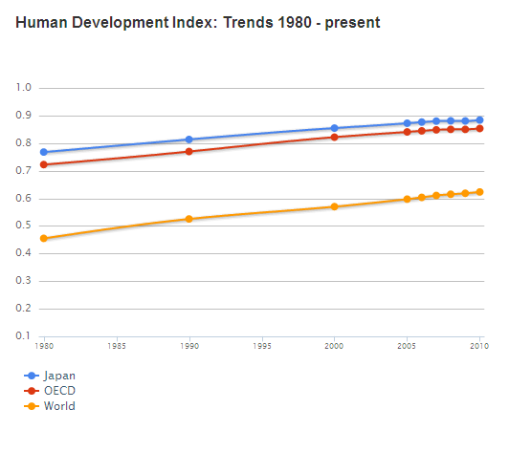
(“Japan:HDI”)

Slide 23
\

Slide 24
Quick History lesson
600 BC
405 AD
Japan was founded by the Emperor Jimmu
Chinese writing system officially adopted
Japans first fixed Capitol at Nara, was Capitol until 1867
710
1542
First documented contact with the West
1650
Japan forced all foreigners to leave, and barred contact with the rest of the world, starting a long period of isolation.
1854
US Navy negotiated the opening of Japan to the West with the Convention of Kanagawa
1868
1894-1895
1905
Feudal system abolished
War with China over Korea
Defeated Russia in War over Korea
1919
WW1 ends with Treaty of Versailles
1930s
Military leaders became increasingly influential
1931
Japan invades Manchuria and sets up a puppet state
1933
1937
1941
Japan resigns from League of Nations
Japanese invasion of China
Japan bombs Pearl Harbor
1945
Japan surrenders after bombings of Hiroshima and Nagasaki. Japan loses all territories except for home islands
1952
Japan regains full sovereignty
1993
Politically, the Liberal Democratic Party dominated Japan until this is the first time the LDP loses its majority
Mid 1990s
After tremendous economic growth for half a century, the bubble burst and resulted in what is now called “the Lost Decade”

Slide 25
Current Events
After half a century of nearly uninterrupted control of government by the Liberal Democratic Party, the Democratic Party of Japan now has power in one of the houses. This splits the power between the LDP and DPJ parties, which many hope will lead to a more representative government. (Funabashi)
“Japan stepped up surveillance on North Korea on Sunday as South Korea and the United States kicked off a joint naval exercise in the Yellow Sea just days after a small South Korean border island was shelled by Pyongyang.” (Japan times)

Slide 26
Type of Government
Classified as a Constitutional Monarchy. It is very similar to the United States political system with 3 branches: Executive, Judicial, and Legislative. Also similar to the US, the legislative branch is bicameral. (CIA Factbook)

Slide 27
Civil Liberties
According to the Constitution of Japan, Citizens have a wide range of civil rights and liberties hard to distinguish from those enjoyed by American citizens. (Constitution of Japan)
Ex: Article 13. All of the people shall be respected as individuals. Their right to life, liberty, and the pursuit of happiness shall, to the extent that it does not interfere with the public welfare, be the supreme consideration in legislation and in other governmental affairs. (Constitution of Japan)

Slide 28
Amnesty International on Japan
Primarily focused on the treatment of prisoners. The ongoing practice of executing convicted criminals is a major concern of AI, with 15 executions being carried out in 2008 and over 100 still on death row.
AI also has issues with the quality of healthcare afforded to prisoners of the state.
Other issues involve the pre-trial detention practices, whereby suspects may be held as long as 23 days with limited access to a lawyer, and the ill-treatment of refugee and asylum seekers. (“Japan | Amnesty International”)

Slide 29
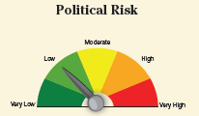
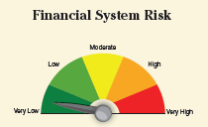
Risk Factor
According to a report released by A.M. Best on Oct. 29th, 2010, Japan is considered an overall low risk country, earning a score CRT-2 on a scale of CRT-1 through CRT-5.
AM Best rates countries based on three categories of risk: Economic, Political and Financial System Risk.
“Consumer demand, stimulated by expansionary fiscal policy, returned in 2010 but not at a steady rate and there is a likelihood that the economy will decelerate again in 2010 to 2011.” (AMB Country Report)

Slide 30
Legal System
“Modeled after European civil law systems with English-American influence; judicial review of legislative acts in the Supreme Court; accepts compulsory ICJ jurisdiction with reservations.” (CIA Factbook)
“To ensure fair judgments, the Japanese judicial system allows a case to be heard and ruled on up to three times in principle, should either party involved in the case so desire. The first courts in the court hierarchy are the District Courts, the second being the High Courts and the highest court being the Supreme Court.” (SHJ)

Slide 31
Innovations in the Legal System
“A new saiban-in (lay judge) system began in May 2009. This is a system under which citizens participate in criminal trials as judges to determine, together with professional judges, whether the defendant is guilty or not and, if found guilty, what sentence should apply.” (SHJ)

Slide 32
Relation to Business
“Japan Corporation Tax Act ("CTA') classifies corporation in two types: domestic and foreign corporations. A domestic corporation is defined as a legal entity with its head office located in Japan. Any other corporation is classified as foreign corporation.” (“Taxation of Corporations in Japan”)

Slide 33
Geography and Climate
Japan has an area of 377,915 sq km, to make this in to terms that are more meaningful it about the size of California. (CIA Factbook)
The terrain is mostly Rugged and Mountainous with the highest point in Japan at Fujiyama at 3,776m
Climate Varies from Tropical in the South to cool temperate in the North. (CIA Factbook)

Slide 34
Environmental Conditions
The 2010 Environmental Performance Index (EPI) ranks 163 countries on 25 performance indicators tracked across ten policy categories covering both environmental public health and ecosystem vitality. Japan scored a 72.5 out of a 100 and ranked 20th out of the 163 countries. The United States in comparison scored a 63.5 coming in 61st place. (“EPI:2010”)

Slide 35
Key Environmental Challenges
“Air pollution from power plant emissions results in acid rain; acidification of lakes and reservoirs degrading water quality and threatening aquatic life; Japan is one of the largest consumers of fish and tropical timber, contributing to the depletion of these resources in Asia and elsewhere” (CIA Factbook)

Slide 36
Response to Environmental Problems
In an effort to combat global warming Japan adopted the Kyoto Protocol. This Protocol commits all nations involved to steadily reducing their greenhouse gas emissions. (“Kyoto Protocol”)
Japan is also a member of numerous international environmental agreements including: Antarctic-Environmental Protocol, Antarctic-Marine Living Resources, Antarctic Seals, Antarctic Treaty, Biodiversity, Climate Change, Climate Change-Kyoto Protocol, Desertification, Endangered Species, Environmental Modification, Hazardous Wastes, Law of the Sea, Marine Dumping, Ozone Layer Protection, and Ship Pollution. (CIA Factbook)

Slide 37
Key Advantages in the Eyes of Foreign Business
Japan has a market of 127 million people, and is the second leading nation in GDP. The population is aging rapidly, which presents problems for Japan, but opportunities for foreign direct investment. With an aging population and relatively few adolescents, there is an increase in disposable income. The risks involved in doing business in Japan are nearly as low as one can find among the industrialized nations; they have a stable economic, political, and financial system. Overall Japan is a country which urges strong consideration for investment.

Slide 38
Sociology
The traditional gender roles—men as breadwinners and women as homemakers—are only supported by only 40 to 50 percent of people (NHK 1994; Ministry of Public Management 1995). Among younger couples, more flexible gender roles are becoming popular. Although attitudes are changing, actual behaviors are not: Japanese men do only twenty to thirty minutes' worth of domestic work per day, while women spend three and a half hours in household chores.
Husbands and wives report very little communication and conversation, as little as ten to fifteen minutes per day. The writer Iku Hayashi first coined the term kateinai rikon (domestic divorce) in 1983 to describe this situation. It means that there is no conversation, communication, and sexual relations between a husband and wife, but they do not divorce.
Roles for mothers and fathers are segregated. Childcare is regarded as the mother's responsibility; the father's domestic role is limited to small household repairs and playing with children on weekends. Full-time working wives also have the burden of housekeeping without help. Domestic help is not popular in Japan. When women need help in housekeeping work and childcare, their mothers help them, and working mothers prefer living close to their mothers' house for this reason. Husbands and wives call each other father and mother, even when children are not around. Japanese couples regard parental roles as more important than couple roles when they have children
Parents are typically More strict
http://family.jrank.org/pages/984/Japan-Gender-Roles.html#ixzz14zs63wJm

Slide 39
Class Structure
Between the 12th and 19th centuries Japan had a 4 tier class system including the Samurai Class, Peasants, Artisans, and Merchants.

Slide 41
Religion
What does religious and religion mean?
Shinto and Buddhism are the major religions in Japan. Many people practice both. However overall religion doesn’t play an important role in every day life.
A survey conducted by japan-guide.com found that 52% of participants felt that they belonged to no religion. 36% felt as though they were Buddhist, and both Shinto and Christianity represented 11%.
A survey conducted by Asahi Shimbun in 1995 found non-believers to be (63%), followed by Buddhists (26%), Shintoists (2%) and Christians (1%).

Slide 42
Education
Japanese schools up to Junior High School are almost exclusively public (less than 5% are privately owned and run). Until Junior High School, students study at the school in whose catchment area their home is located. However, senior high schools have overlapping catchment areas: this means that there is competition among schools for the best pupils in a particular area, and among pupils for places at the best schools. Over one-quarter of senior high schools are private, indicating the extent of the competition in the higher levels Japanese schooling: parents will pay substantial amounts for their children's educations.
School attendance rate for the nine years of compulsory education is 99.98%.
More than 90% of all students graduate from high school and 40% from university or junior college. 100 % of all students complete elementary school and Japan is repeatedly said to have achieved 100% literacy and to have the highest literacy rate in the world since the Edo period.
Some question overall effects of stress in education. 12 hour days are typical.
http://educationjapan.org/jguide/school_system.html

Slide 43
Leisure Activities

Slide 44
Interesting Leisure Trends
The number of people who participated in "Studies and researches" in the past year was 39,980,000; the participation rate was 35.2%.
The majority of participants in "English language" studied for 1 day or more per week.
74,236,000 people engaged in "Sports" in the past year, the participation rate was 65.3%, decreasing by 6.9 percentage points, compared to 5 years ago.
"Playing home use video games PC games" increased dramatically; "Karaoke", "Playing ‘Pachinko’" decreased over the past 2 decades.

Slide 45
Arts
Painting
Ceramics
Calligraphy
Sculpture
Ukiyo-e
Ikebana
http://www.youtube.com/watch?v=08c-t0eqgU0

Slide 46
Calligraphy

Slide 47
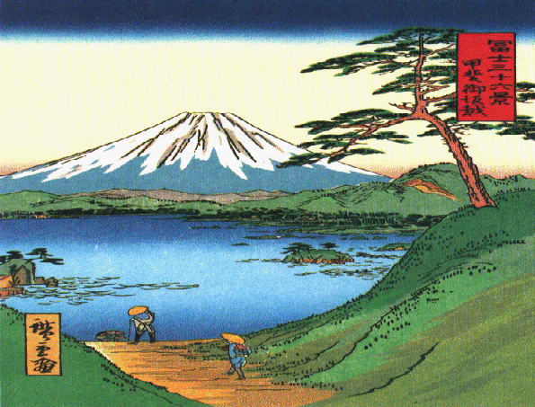
Ukiyo-e (Pictures of Floating World)

Slide 48
Ikebana

Slide 49
Rice Paddy Art

Slide 53
Anime in the United States

Slide 55
U.S. Cartoon Turned

Slide 56
Hofstede Model

Slide 57
Kluckhohn & Strodtbeck
Category | View Point
Nature of Humans | Good/Evil: The basic nature of people is essentially good or evil.
Relations Among People | Collective: Our primary responsibility is to and for a larger extended group of people, such as an extended family or society.
Relation to Broad Environment | Harmony: We should strive to maintain a balance among the elements of the environment, including ourselves.
Activity | Thinking: People should consider all aspects of a situation carefully and rationally before taking action.
Time | Past: Our decision criteria should be guided mostly by tradition.
Space | Private: The space around someone belongs to that person and cannot be used by anyone else without permission

Slide 58
Trompenaar and Hampden-Turner's
Category | View Point
Universalism vs. Particularism | Universalism
Communitarianism vs. Individualism | Communitarianism
Neutral vs. Emotional | Emotional
Diffuse vs. Specific | Diffuse
Achievement vs. Ascription | Ascription
Attitudes to Time | Long Term
Attitudes Toward the Environment | Harmony, Uncontrollable

Slide 59
Cultural Norms
Honne vs. tatemae
Real opinion vs. public opinion
Study business card and remember names
Use formal titles unless told otherwise
Tipping not expected
Shishi Dogs

Slide 60
Gift Giving Related to Business
Gift giving is essential
One of the most important parts of the gift giving is the presentation of the gift.
It is important to tell them that you have a gift for them during the meeting, and not just surprise them with a gift.
The gift itself should not be too expensive.

Slide 61
Key holidays and ceremonies
1 January - 元日 (New Year's Day)
Second Monday of January - 成人の日 (Adult's Day)
11 February - 建国記念の日 (National Foundation Day)
21 March (approx.) - 春分の日 (Vernal Equinox Day)
29 April - 緑の日 (Green Day)
3 May - 憲法記念日 (Constitution Day)
5 May - 子どもの日 (Children's Day)
15 September - 敬老の日 (Respect-for-the-Aged Day)
22 September (approx.) - 秋分の日 (Autumnal Equinox Day)
10 October - 体育の日 (Sports Day)
3 November - 文化の日 (Culture Day)
23 November - 勤労感謝の日 (Labour Thanksgiving Day)
23 December - 天皇誕生日 (Emperor's Birthday)
Japan has 13 Public Holidays

Slide 62
Communication
Language spoken
Business language
Conflict Style
Verbal cues are essential to understanding true meaning of the conversation.

Slide 63
Meeting Time: 3:00 p.m.

Slide 64
Current Time
2:45 p.m.

Slide 65
3:00 p.m.

Slide 66
What Went Wrong?

Slide 67
Meeting Times
Japanese businessmen arrive at meetings earlier than the time agreed upon. They also expect the same from the other participants.
Japanese meetings (especially negotiations) typically take longer than U.S. transactions.

Slide 68
Greetings
Meishi, the exchange of business cards is very important.
Take their card with both hands and bow at waist not head.
Examine card and remember the name and title of the individual.
U.S. members should have translation in Japanese on back of their card.

Slide 69
Starting
U.S. businessmen must remember not to get straight to the point. Japanese associates like to participate in small talk and build relationships.

Slide 70
Negotiation
Purchasing/decision making power
“cards are on the table”
Immediate gains
Clear and explicit communication
Aggressive
Persuasion
Limited authority
Tatemae (public opinion)
Long term gains
Hidden and implicit communication
Conflict avoidance
Western Style
Japanese Style

Slide 71
Negotiations Continued
Japanese seldom concede position
Expect everyone to come to the table with their best offer.
Do not see contracts as final, so they can be renegotiated.
Prefer broad agreements and flexibility.

Slide 72
Closing
Silence is not a deal breaker, let Japanese associates think, and wait for a response.
As a result of avoidance of conflict and language barrier, they may seem to be agreeing while actually just acknowledging they understand what you are saying.
Some Japanese people close their eyes to listen intently.

Slide 73
Phrasing Questions
Japanese people tend to say “yes” even when they mean no.
If you sense this is occurring phrase questions in a way that allows them to say “yes.”
Do you disagree with this?

Slide 74
Take Away
First meeting is typically about building a relationship.
Trading business cards is important a doing so correctly starts the meeting off on a good note.
Remember differences in styles.
Silence is not always bad.

Slide 75
Work Cited
Marincich, Chrystel, Dir. Negotiating With Japanese Companies. 2010, Film. <http://www.youtube.com/watch?v=UHTZcOxAje8&feature=player_embedded>.

Slide 76
Business Environment
Technology
Distribution Structure
Ethics
Business Relationships
Impression of American

Slide 77
Technology
Japan is one of the leading nations in the fields of scientific research, particularly technology, machinery and biomedical research.
Japan has a large industrial capacity and is home to some of the largest, leading and most technologically advanced producers.
Japanese consumer electronics industry is one of the most prominent industries

Slide 78
Distribution Structure
Consumers’ practice of purchasing goods in small lots and at frequent intervals.
The fact that the majority of small-sized retail stores are run as family businesses
Preferential tax treatments granted to these retail stores
the existence of legal restraints on large-scale retail stores.
the role performed by these stores as a meeting place for neighborhood residents.

Slide 79
Business Ethics
The Ethics of Diligence and Self-Actualization
The Ethics of the Group
The ethics of reciprocity

Slide 80
Other Business Ethic
Japanese are very loyal to their superiors and this determines a certain restraint towards those who do not belong to the company they work for.
The people who is good at maintaining harmony is likely to be promoted.
Two persons that have the same profession, cannot even be taken into consideration.

Slide 81
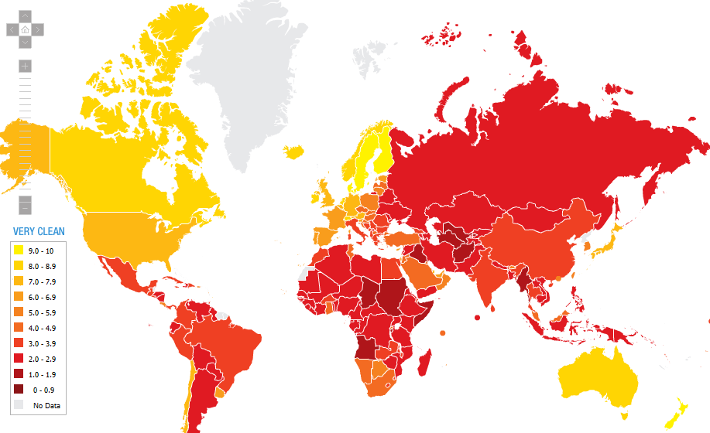
Transparency Level

Slide 82
Business Relationships
Business relationship is most important in Japan. Most of Japanese business based on personal, tight and previously established relations.
A mutually beneficial distributor-supplier relationship will entail an exchange of valuable commercial information.
Adaptations and improvements will be a necessary element for capturing or keeping market share and will strengthen the supplier-customer relationship.
Face-to-face contact is the best way to pursue business relationships

Slide 83
Impression of Americans
The majority of Japanese still believe that the Caucasian-American controls everything and the African American is a semi-slave.
Individualism
House, big cars, junk food lifestyle,
Activities don’t have as much rules as in Japan.

Slide 84
Management Aspect
Typically management style
Typical leadership style
Decision making process
Primary means of motivating employees
Common type of organization structure
Women in Business in Japan

Slide 85
Hiring practices and preferences
Some major Japanese companies use as lifetime employment and seniority to compete in an increasingly global business environment.
Most employees will not ask for salaries that are significantly higher than others with comparable responsibilities.
In some cases, Japanese companies may pay a higher salary to a foreigner depending on his or her expertise and the job.

Slide 86
Compensation structure
（1）Bonous
（2）Incentive system
（3）Employee share ownership schemes

Slide 87
Wage
The Big Mac Index shows that Japanese workers get the
highest salary per hour in the world
Receiving salaries in 14 equal parts, 12 of which are paid monthly and the other two in June.
Additional bonuses are paid to employees in the form of extra payments in early December.
Foreign employees may be paid on the Western system of 12 months' pay plus a bonus.
Companies encourages employees to save money for such things such as large consumer purchases, children's education, or buying a house.
the minimum wage for a foreigner on a full time visa would be 250,000 or roughly $2,500 USD a month or roughly $30,000 a year.

Slide 88
Advancement practices
The Japanese philosophy is that only the company in which the human relations are good will succeed in while the one with bad human relations will go bankrupt.
The seniority system still dominates the pay scale in Japan, even though some major companies are trying to reverse this trend slowly.

Slide 89
Key employment laws
The Labor Standards Law was first enacted in 1947 and has since been amended several times.
on 1 April 2010. The Labor Contract Law was enacted in 2007 and came into effect on 1 March 2008. It codifies important principles of employment contracts, most of which were historically based on court precedents.
Special Labor Laws and Working Conditions Equal Employment Opportunities for Women

Slide 90
Benefits for employees
Benefits generally fall into several categories: housing, transportation, special family allowances, vacation, sick leave, pension and health benefits.
Single employees may be offered dormitory housing, and there may be travel allowances for commuting to and from the office. There may also be special family allowances, rental benefits, expenses for business trips, and allowances for relocation. The amount of each of these kinds of benefits is determined by the employee’s level in the company (seniority, title responsibilities) or, in some cases, by whether the employee has an ownership position in the company.
Vacation
Sick leave. Many companies require a doctor’s report if an employee is to use more than three days of sick leave.

Slide 91
Appropriate business dress
Japanese business attire must be formal.
Wear dark suits (navy or black) with white shirt and subdued tie from October - April and gray suit from May - September.
Wear half-sleeve shirts during the summer months.
Japanese men typically have well groomed short hairstyles.
Do not wear black suit, white shirt and black tie because that is funeral attire.
Business cards are as important as formal affaire.

Slide 92
Work schedule
The typical Japanese workweek is Monday
through Friday, 9:00 a.m. to 5:00 p.m. lunch
break is between 12:00pm and 1:00 p.m. sharp.

Slide 93
Business meeting behavior
Dressing
seating arrangement
Taking notes
Business Cards
Gifts are always appreciated

Slide 94
Dos and don’ts
Do not think quietness as an indication that an individual is not knowledgeable. The Japanese are apt to remain silent
Do not make inappropriate comments in English and think they could not understand.
Be patient with non-native English speakers, and do not interrupt.
Remember to carry your Japanese business cards!
Do not blow your nose in a public place (including meeting rooms).
Do not grab your host's hand when first meeting and give it a hearty shake
Never make derogatory remarks about anyone, including your competitors and own employees.

Slide 95
Interviews
Ken Murakami -Waseda University
Taught in English
Worked before attending MBA
Says MBA in Japan is not as popular (saught after) as it is in U.S.
Yohei Takagi -Tokyo University of Science
Worked for JASTEC, an IT company for six
Wants more growth potential, opportunities abroad

Slide 96
Interviews
Chieko Mitome- Meiji University
Mother of three
Worked for a while, quit to raise family
Now single mother, got MBA to support family (more marketable)
Naoki Matsuoka- Nagoya University
Company sponsored MBA
Worked prior to obtaining MBA (6 years)
Wants to improve his own knowledge and that of others

